Slide 1
Exploratory Data Analysis, Stats, and Visualization
Jay Urbain, PhD

Slide 2
Data Exploration Topics
Sampling
Distributions
Aggregate statistics
Principles of visualization

Slide 3
Data Science Process
Ask questions – hypothesize
Data collection
Data exploration
Data modeling
Data analysis
Visualization and communication of results

Slide 4
Basics of sampling
Population versus sample:
A population is the entire set of objects or events under study. Population can be hypothetical “all students” or “all students in this class.”
A sample is a “representative” subset of the objects or events under study. Needed because its impossible or intractable to obtain or compute with population data.
Biases in samples:
Selection bias: some subjects or records are more likely to be selected.
Volunteer/nonresponse bias: subjects or records who are not easily available are not represented.
Examples?

Slide 5
Distributions
Distribution: Set of all possible random variables
Example distributions:
Flipping coins for heads and tails
binomial (two possible outcomes, e.g., heads or tails)
discrete (categories of students, no real numbers)
evenly weighted (each category of students is equally likely; heads have same probability of tails)
Tornado events in Milwaukee?
binomial
discrete
evenly weighted (note: tornadoes are rare events)

Slide 6
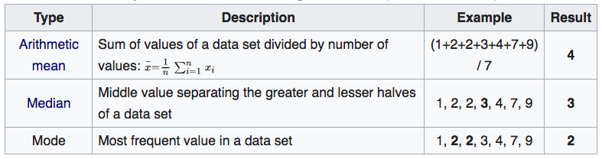
Central measures

Slide 7
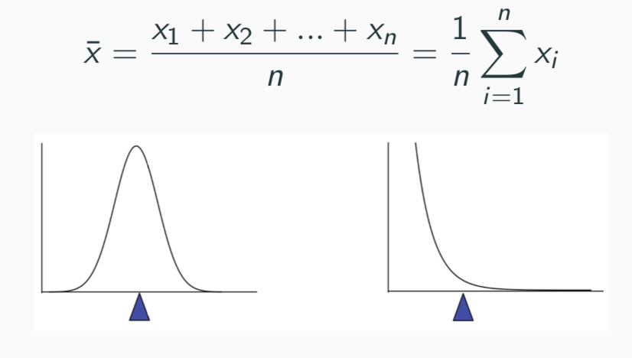
Sample mean
The mean of a set of n observations of a variable is denoted x ̄ and is defined as:
The mean describes what a “typical” sample value looks like, or where is the “center” of the distribution of the data.
There is always uncertainty involved when calculating a sample mean to estimate a population mean.

Slide 8
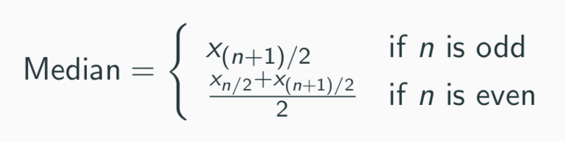
Sample median
The median of a set of n number of observations in a sample, ordered by value, of a variable is is defined by:
Example (already in order):
Ages: 17, 19, 21, 22, 23, 23, 23, 38
Median = (22+23)/2 = 22.5
The median also describes what a typical observation looks like, or where is the center of the distribution of the sample of observations.

Slide 9
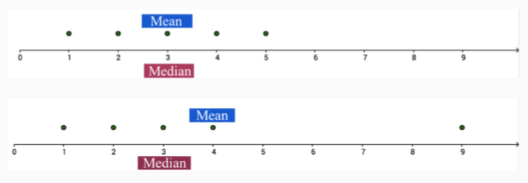
Mean vs. Median
The mean is sensitive to extreme values (outliers)

Slide 10
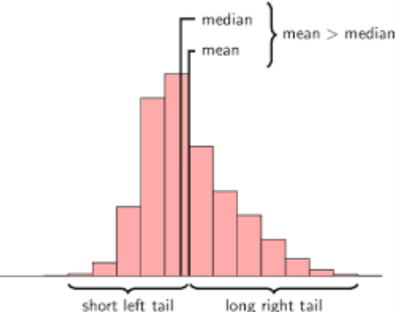
Mean vs. Median
The mean is sensitive to extreme values (outliers)
The above distribution is called right-skewed since the mean > median.

Slide 11
Mode, median, mean

Slide 12
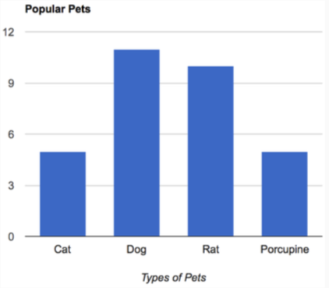
Central measures: categorical variables
For categorical variables, neither mean or median make sense.
Why?
The mode might be the way to find the most representative value.

Slide 13
Central measures: computation
Computational time complexity:
Mean: O(n)
Median: O(n*lg(n)) # with comparison sort
Mode: O(n) to O(n*lg(n)) # dependent on data structure

Slide 14
Measures of Spread: Range
The spread of a sample of observations measures how well the mean or median describes the sample.
One way to measure spread of a sample of observations is via the range.
Range = Maximum Value - Minimum Value

Slide 15
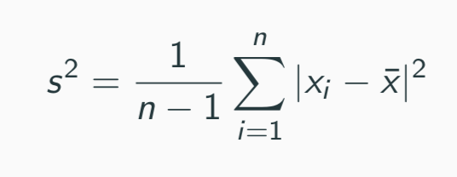
Measures of Spread: Variance
The (sample) variance, denoted s², measures how much on average the sample values deviate from the mean:
Note: the term |x_{i} − x ̄| measures the amount by which each x_{i} deviates from the mean x ̄. Squaring these deviations means that s² is sensitive to extreme values (outliers).
Note: s² doesn't have the same units as the x_{i.} What does a variance of 1,008 or 0.0001?

Slide 16
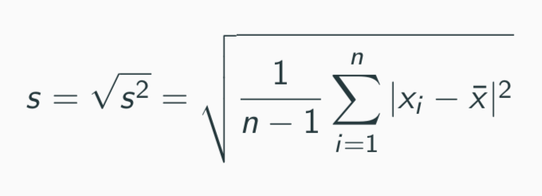
Measures of Spread: Standard Deviation
The (sample) standard deviation, denoted s, is the square root of
the variance:
Note: s does have the same units as the x_{i} .

Slide 17
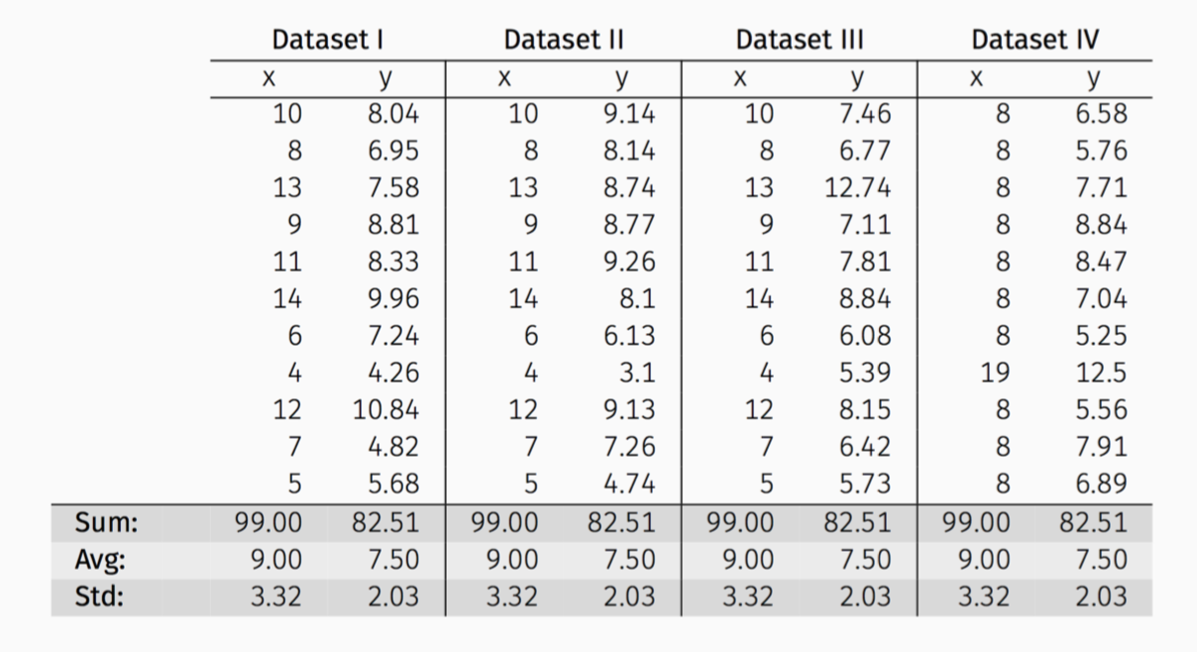
Anscombe’s Data
The following four data sets comprise the Anscombes Quartet.
All four sets of data have almost identical simple summary statistics.

Slide 18
Anscombe’s Data
Summary statistics clearly don’t tell the story of how they differ.
But a picture often can:

Slide 19
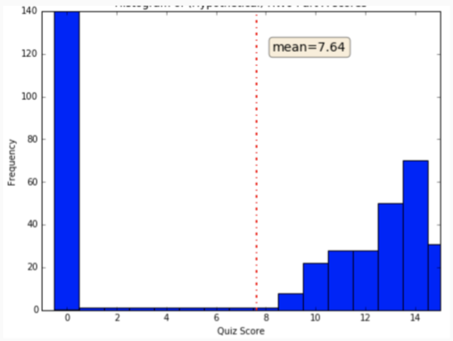
Visualization Motivation
The average score for the quiz is 7.37/15. What does this suggest?
What does the graph suggest?

Slide 20
Principals of Visualization
Visualizations help us analyze and explore the data. They help:
Identify hidden patterns and trends
Formulate/test hypotheses
Communicate:
Present information and ideas succinctly
Provide evidence and support
Influence and persuade
Determine the next step in analysis/modeling

Slide 21
More visualization motivation
Visualizations help us to analyze and explore the data:
Identify hidden patterns and trends
Formulate/test hypotheses
Communicate modeling results
Present information and ideas succinctly
Provide evidence and support
Influence and persuade
Determine the next step in analysis/modeling

Slide 22
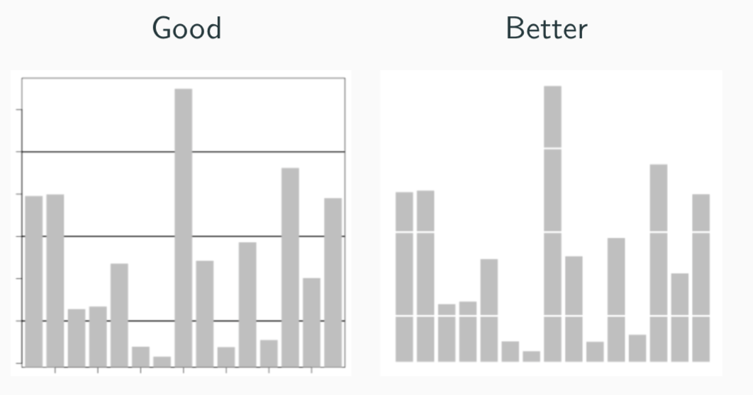
Principals of Visualization
Some basic data visualization guidelines from Edward Tufte:
1. Maximize data to ink ratio: show the data

Slide 23
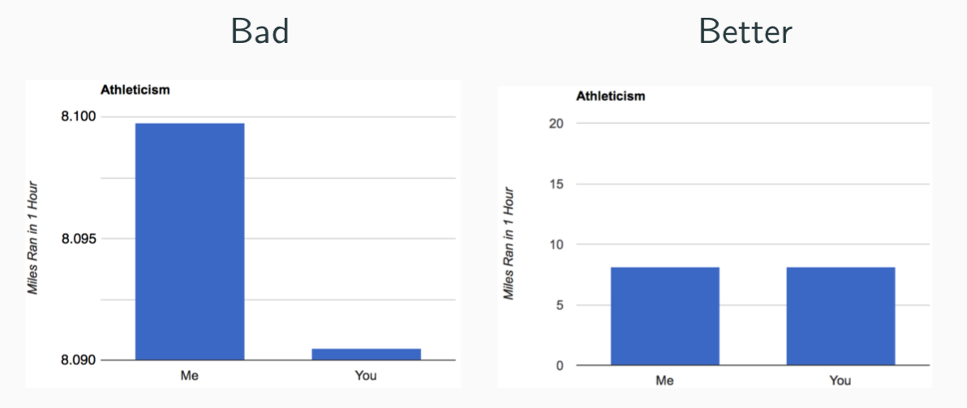
Principals of Visualization
Some basic data visualization guidelines from Edward Tufte:
Maximize data to ink ratio: show the data.
Don’t lie with scale: minimize size of (Lie Factor) :
(effect in graph)/(size of effect in data)

Slide 24
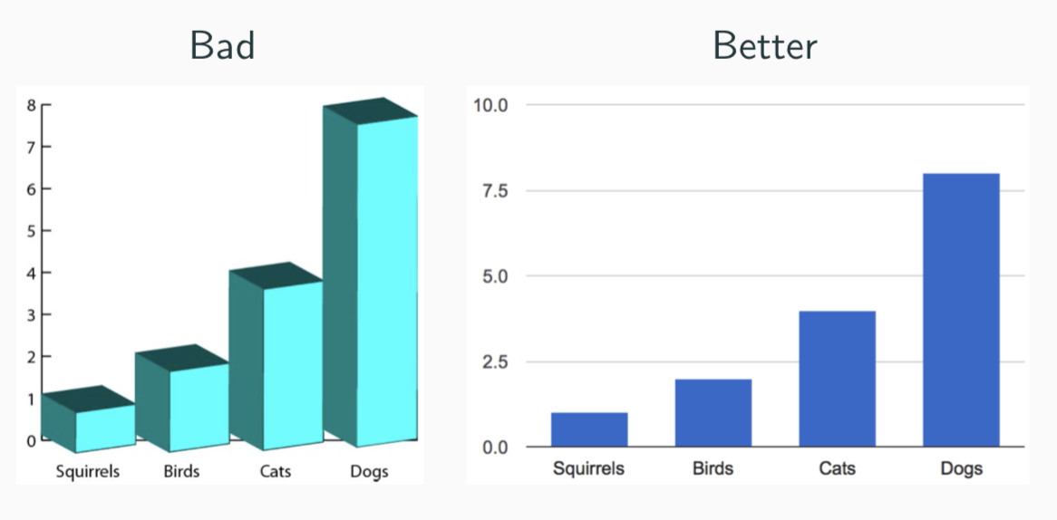
Principals of Visualization
Some basic data visualization guidelines from Edward Tufte:
Maximize data to ink ratio: show the data.
Don’t lie with scale: minimize size of (Lie Factor) :
(effect in graph)/(size of effect in data)
3. Minimize chart-junk: show data visualizations, not design variation

Slide 25
Principals of Visualization
Some basic data visualization guidelines from Edward Tufte:
Maximize data to ink ratio: show the data.
Don’t lie with scale: minimize size of (Lie Factor) :
(effect in graph)/(size of effect in data)
3. Minimize chart-junk: show data visualizations, not design variation
4. Clear, detailed and thorough labeling
More on Tufte principals of visualization:
http://www2.cs.uregina.ca/ rbm/cs100/notes/spreadsheets/tufte paper.html

Slide 26
Types of Visualization
What do you want your visualization to show about your data?
Distribution: how a variable or variables in the dataset distribute over a range of possible values.
Relationship: how the values of multiple variables in the dataset relate.
Composition: how the dataset breaks down into subgroups.
Comparison: how trends in multiple variable or datasets compare.

Slide 27
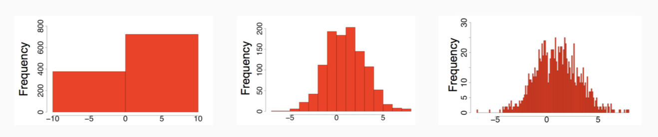
Histograms to visualize distributions
A histogram is a way to visualize how 1-dimensional data is distributed across certain values.
Trends in histograms are sensitive to number of bins.

Slide 28
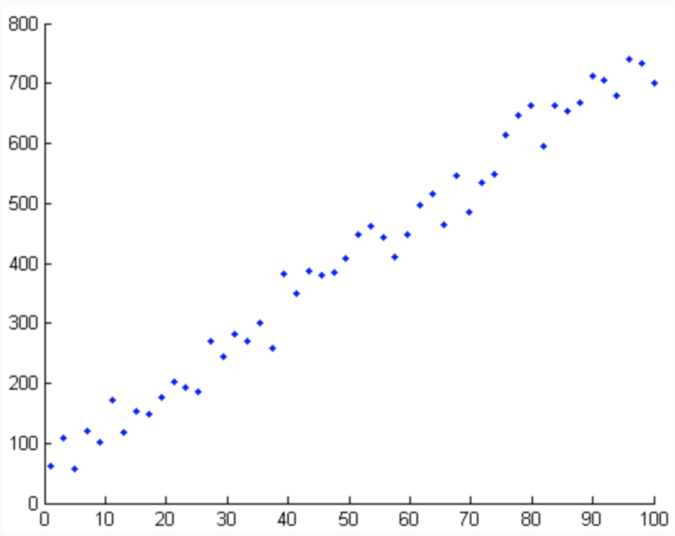
Scatter plots to visualize relationships
A scatter plot is a way to visualize how multi-dimensional data are distributed across certain values.
A scatter plot is also a way to visualize the relationship between two different attributes of multi-dimensional data.

Slide 29
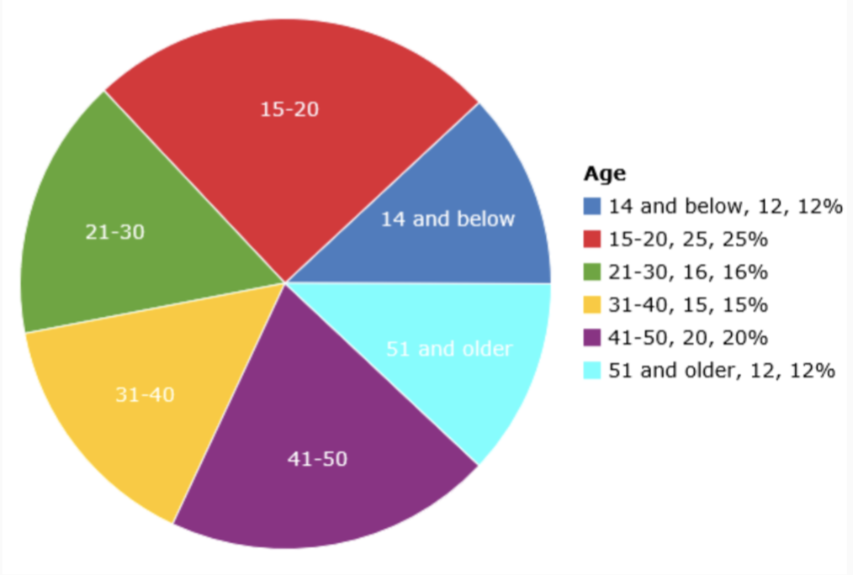
Pie chart for categorical variable
A pie chart is a way to visualize the static composition (i.e., distribution) of a variable (or single group).
Tufte says use bar chart.

Slide 30
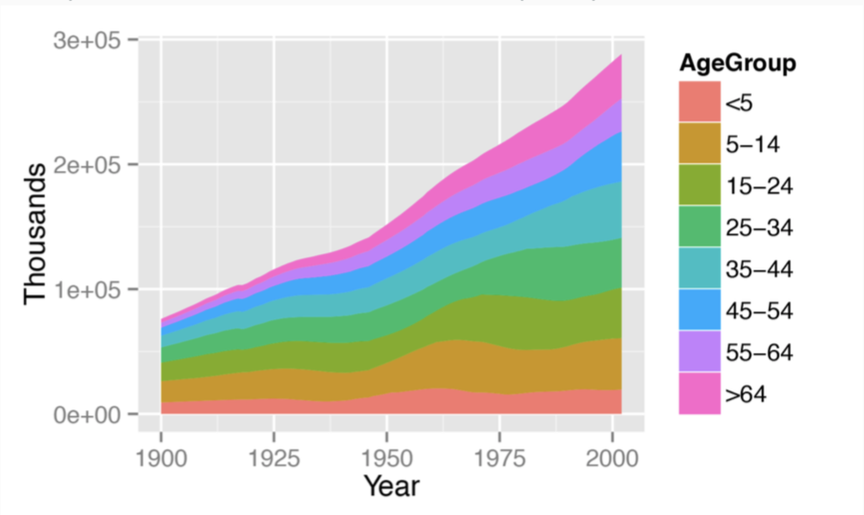
Stacked area graph to show trend over time
A stacked area graph is a way to visualize the composition of a group as it changes over time (or some other quantitative variable).
This shows the relationship of a categorical variable (AgeGroup) to a quantitative variable (year).

Slide 31
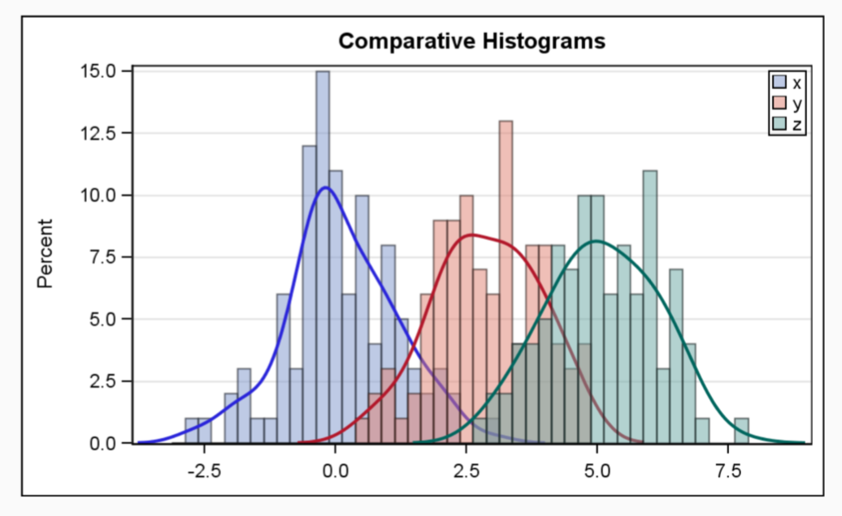
Multiple histograms
Plotting multiple histograms and/or distribution curves on the same axes is a way to visualize how different variables compare (or how a variable differs over specific groups)

Slide 32
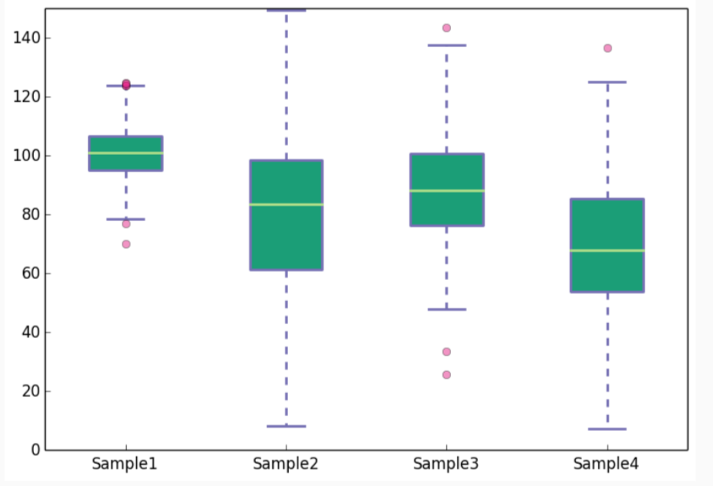
Boxplots
A boxplot is a visualization to compare a quantitative variable across groups.
It highlights the range, quartiles, median and any outliers present in a data set.

Slide 33
Data complexity
Often your dataset seems too complex to visualize:
Data is too high dimensional
How do you plot 100 variables on the same set of axes?)
Some variables are categorical (how do you plot values like Cat or No?)

Slide 34
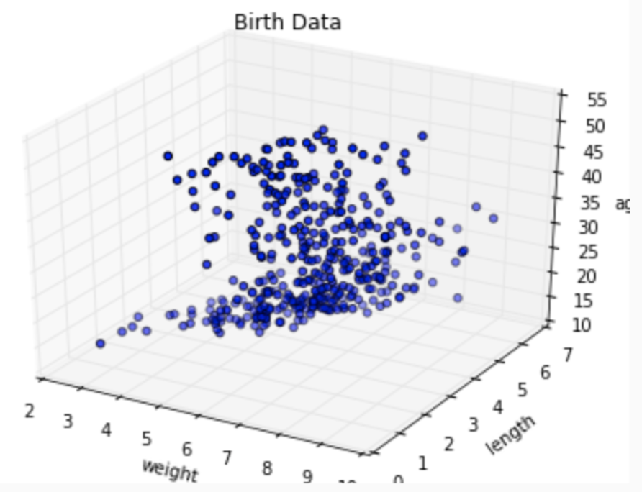
More dimensions not always better
When the data is high dimensional, a scatter plot of all data attributes can be impossible or unhelpful.

Slide 35
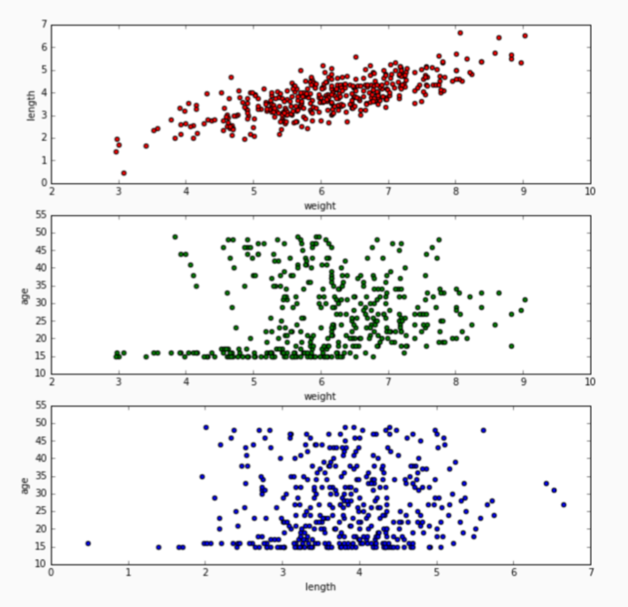
Reducing complexity
Relationships may be easier to spot by producing multiple plots of lower dimensionality.

Slide 36
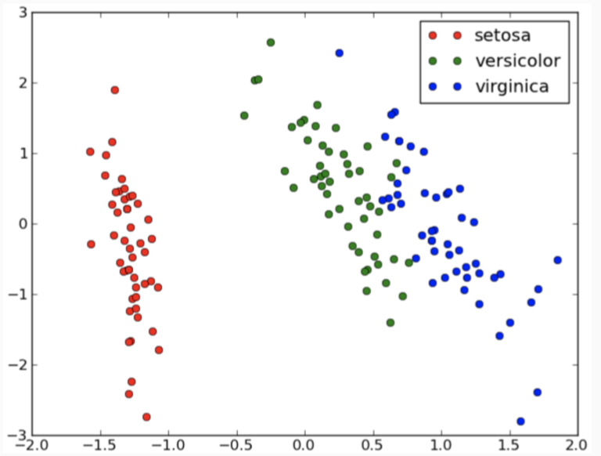
Adding a dimension
For 3D data, color coding a categorical attribute can be effective.
The above visualizes a set of Iris measurements. The variables are: petal length, sepal length, Iris type (setosa, versicolor, virginica).

Slide 37
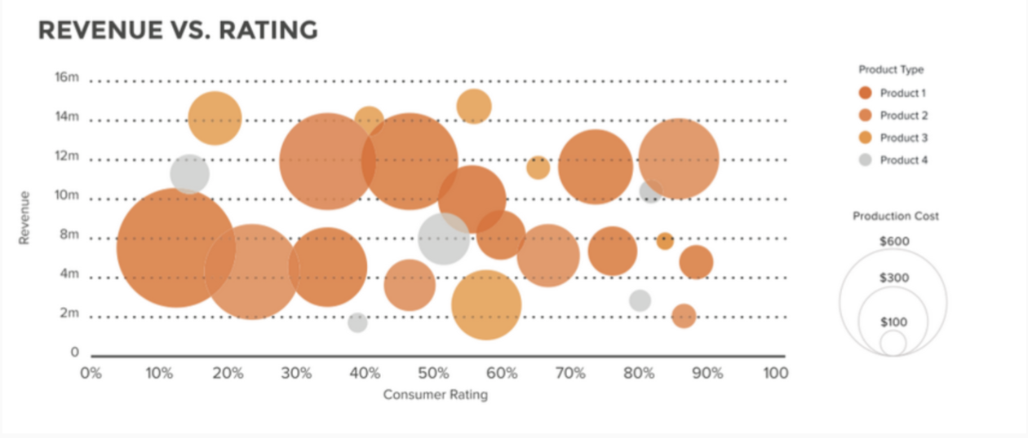
3D
For 3D data, a quantitative attribute can be encoded by size in a bubble chart.
Visualization of a set of consumer products. The variables are: revenue, consumer rating, product type and product cost.

Slide 38
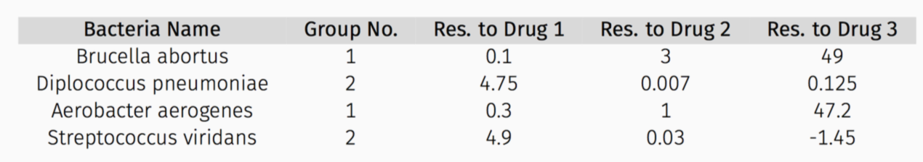
Example dataset
Some visualizations for the following dataset:

Slide 39
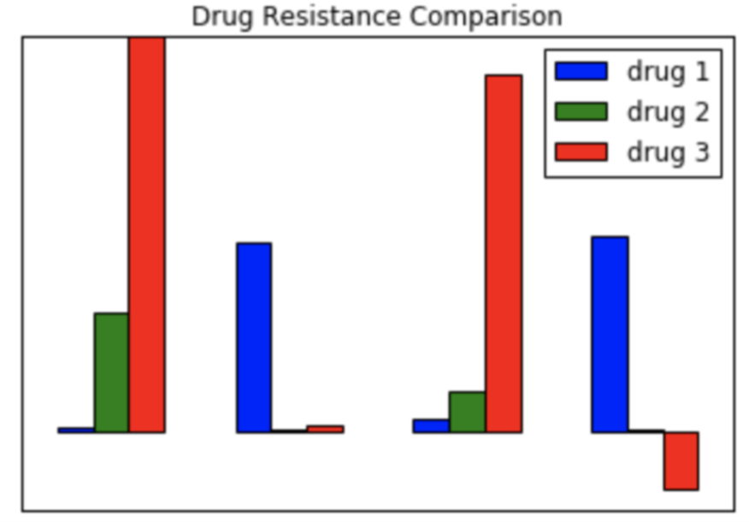
Example
A bar graph showing resistance of each bacteria to each drug:
Issues?

Slide 40
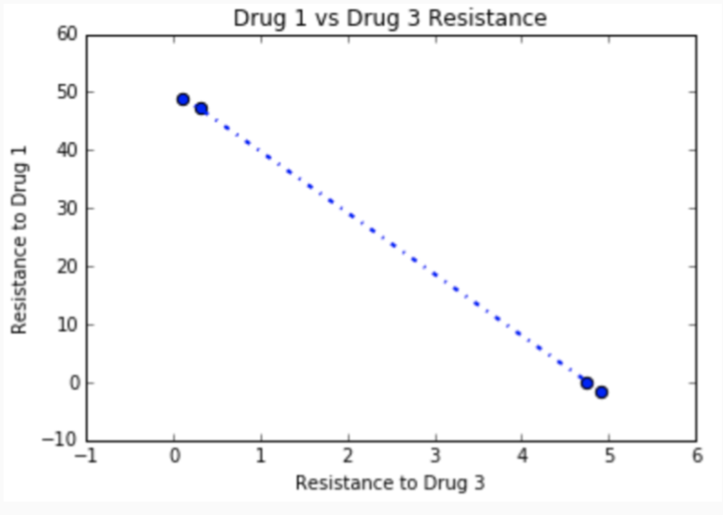
Example
A scatter plot of drug #1 vs. drug #3 resistance.
Key idea: the process of data exploration is iterative.

Slide 41
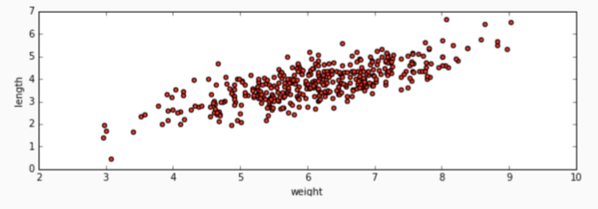
Quantifying Relationships
We can see that birth weight is positively correlated with femur length.
Can we quantify exactly how they are correlated? Can we predict birthweight based on femur length (or vice versa) through a statistical model? See notebook.

Slide 42

Prediction
We can see that types of iris seem to be distinguished by petal and sepal lengths.
Can we predict the type of iris given petal and sepal lengths through some sort of statistical model?

